Slide 1

Churn Forecasting
Customer Churn Forecasting
Final Project Demo
Machine Learning
INFO 656-01
By Erik Hannell

Slide 2
Churn Forecasting
Agenda
1
2
Project Background & Information
Code Walkthrough
Introduction
Project: Develop machine learning models to predict “churn”, i.e., customer loss
Problem: Forecasting customer churn / improving client retention
Dataset: Customer database from a Telecom company, provided by IBM Knowledge Center, retrieved from Kaggle.com
Models: Logistic Regression, Random Forest, Layered Neural Network

Slide 3


Churn Forecasting
Problem – Forecast client behavior
Companies benefit from understanding consumer behavior
One of the most crucial behavior metrics is ”churn”, i.e., the event of losing customers
Businesses strive to minimize churn by optimizing customer retention
Problem – businesses will suffer if they are not engaged in, or unable to conduct, churn forecasting

Slide 4



Churn Forecasting
Why – Key Succuss Factor
Businesses who are successful in predicting customer behavior – particularly churn – will benefit financially
The cost of acquiring new clients typically exceeds that of retaining current ones
New client acquisition has historically been approximately 5-7x more expensive
Why – analyze clients and forecast churn to improve the company performance and client satisfaction
New Client Acquistion
Cost: 500 USD
Client Retention
Cost: 100 USD

Slide 5
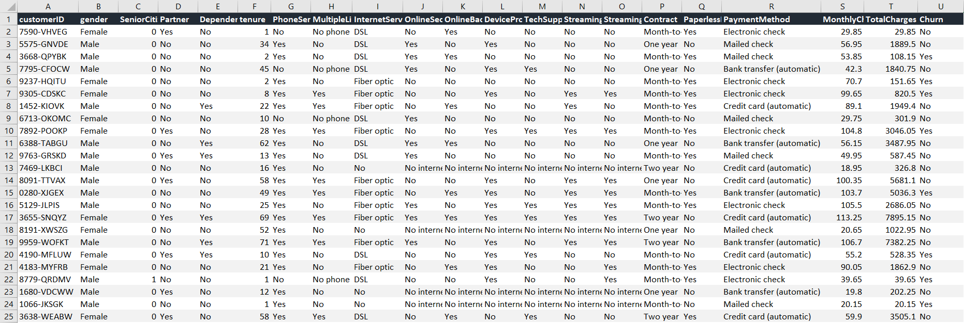
Churn Forecasting
About the Dataset
Each row represents one customer
The Feature Variables contains both categorical and continuous data
Target Variable is binary (Yes / No)
Feature Variables
Target Variable Churn

Slide 6
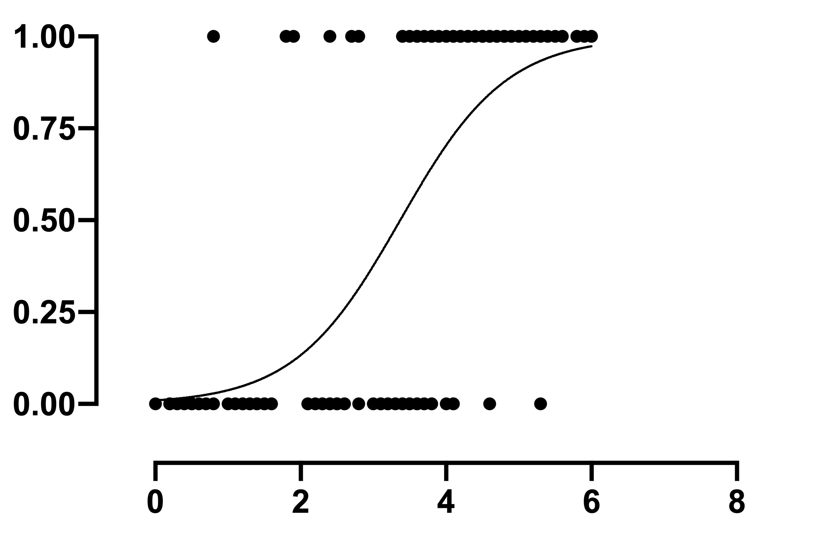
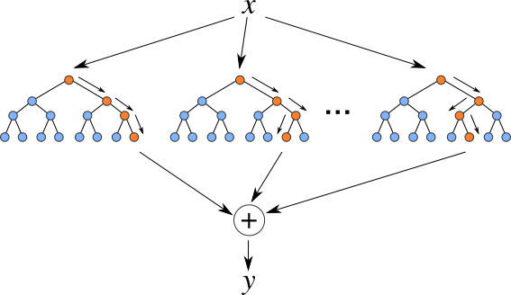
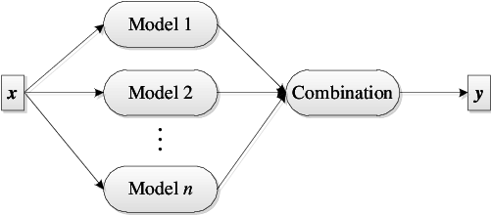
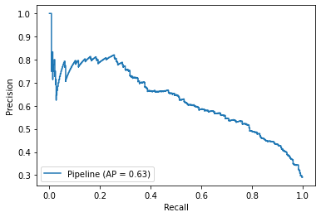
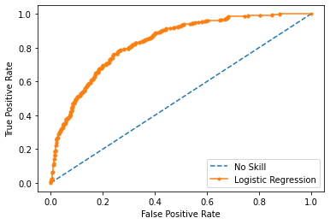
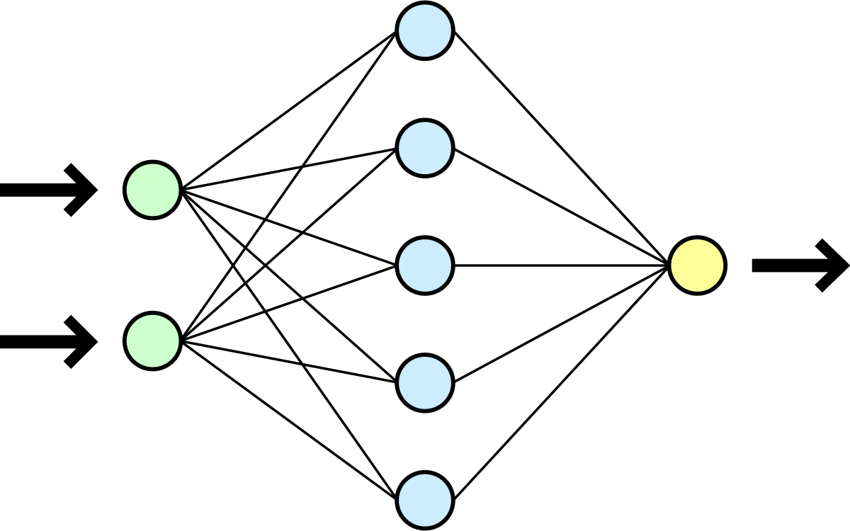
Churn Forecasting
How ?
Step 1: Traditional Machine Learning
Logistic Regression
Random Forest
Ensemble Model
Step 2: Deep Learning
Step 3: Assess, Select & Save
Neural Net Classification

Slide 7
Churn Forecasting
NOTEBOOK DEMO

